Slide 1



@CanCodeToLearn
#CanCodeToLearn

Slide 2


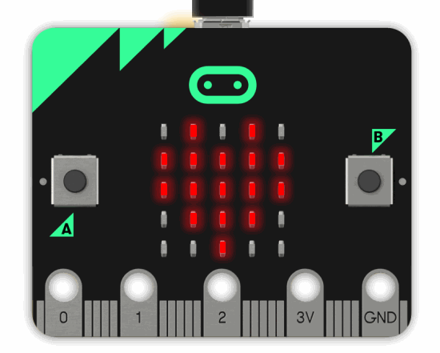
LYNX & micro:bit
WELCOME!
Brenda Sherry – bsherry@takingitglobal.org
Peter Skillen – peter@codetolearn.ca
lynxcoding.club
microbit.org

Slide 3

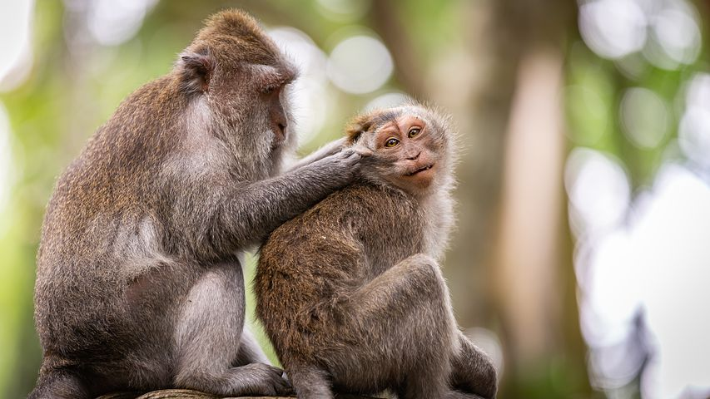
Caring for each other, having fun while we learn!
Notes:
All around the world, we are focused on caring for each other, big time, right now. We are making adjustments as we work from home, or have our school happening at home. We wanted to have some fun while we learn today...so we are so glad that you are here!

Slide 4
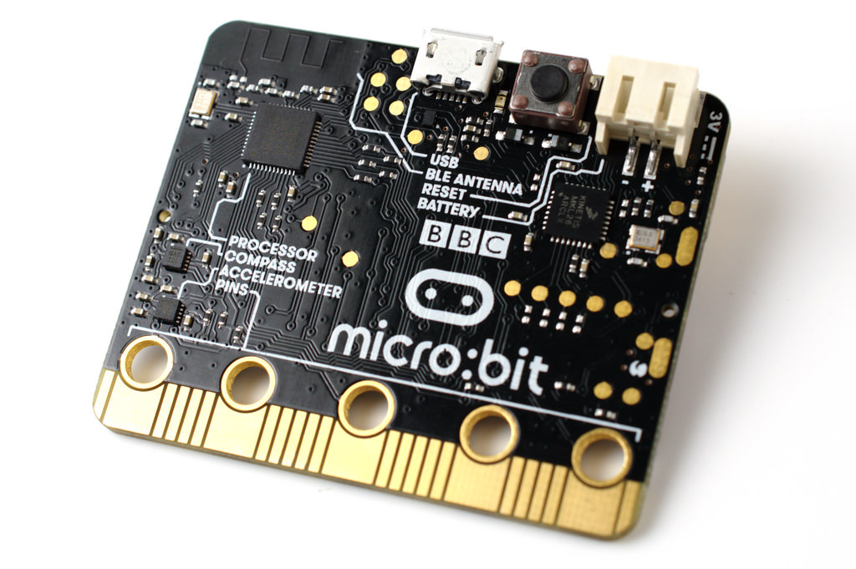
Getting Started with micro:bit
Notes:
Session designed for people who are new to micro:bit - if you already have micro:bits or know lots about micro:bits, you can share what you know in the chat, answer questions, tweet out your creations, or even just move off and explore on your own - we are going to go pretty slowly. We usually do this kind of a workshop in person, too, so this is new for all of us. You can watch while I do - and check it out later, or you can follow along as well go! Whatever suits you. The recording will also be posted too, so you could even watch and participate in the discussion...and then do the coding later as you watch and pause the recording - lots of options!

Slide 5

What if kids don’t have a micro:bit????
Notes:
So we thought about it and wondered...what will we do if you don’t have a micro:bit? Maybe you know about them, but they are in your Library learning commons at school or at the public library or makerspace. Can we still have fun with them? YES - the coding is done online, so all of you will be able to participate.

Slide 6
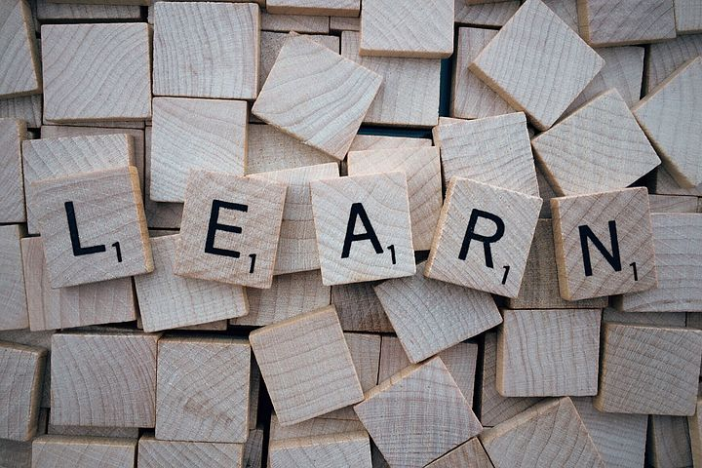
Notes:
We usually work with kids and micro:bits in classrooms...not online...and I’m not an expert! We will be doing some learning together here - we might get stumped, solve problems together and fix bugs in our program. That’s the fun of coding. I think more than anything I’m here to give you some tips about HOW to LEARN how to LEARN microbits.

Slide 7
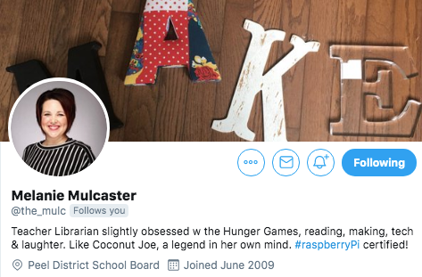
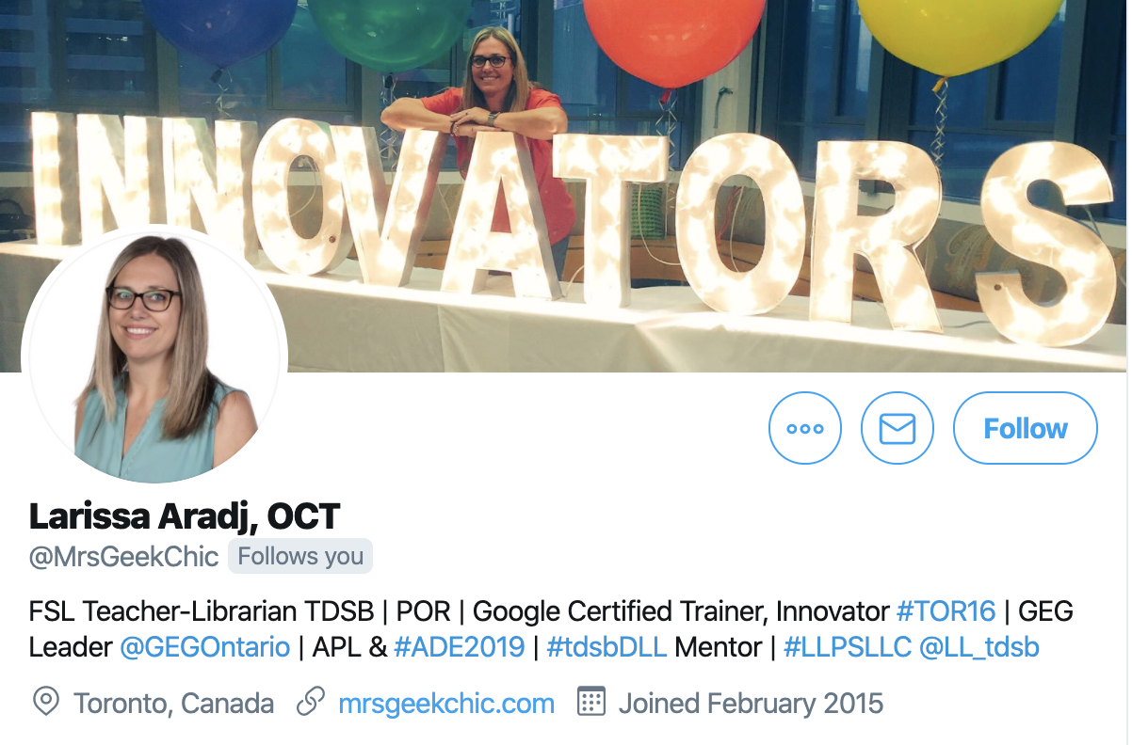
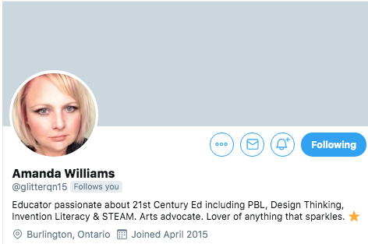
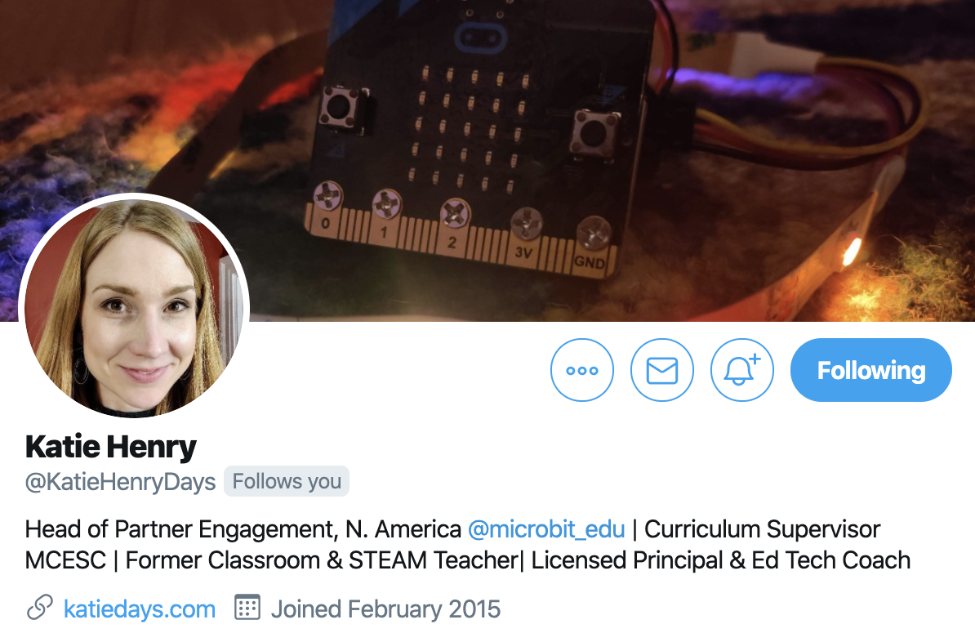
@microbit_edu #microbit
Notes:
One of the things that I do when I’m learning something new is check with my online learning network. I follow the microbit edu account and the hashtag microbit and I follow other educators who are also using microbits. Many of the things that Amanda and Melanie do involve tying your favourite stories and books to design challenges and I find that really fun...because I love books and coding...so you might have some fun ideas about how you could combine what you are reading at home with coding!

Slide 8
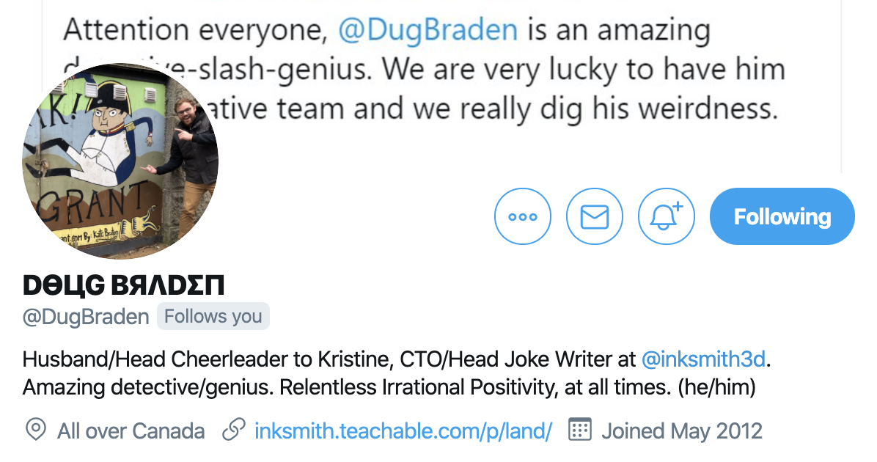
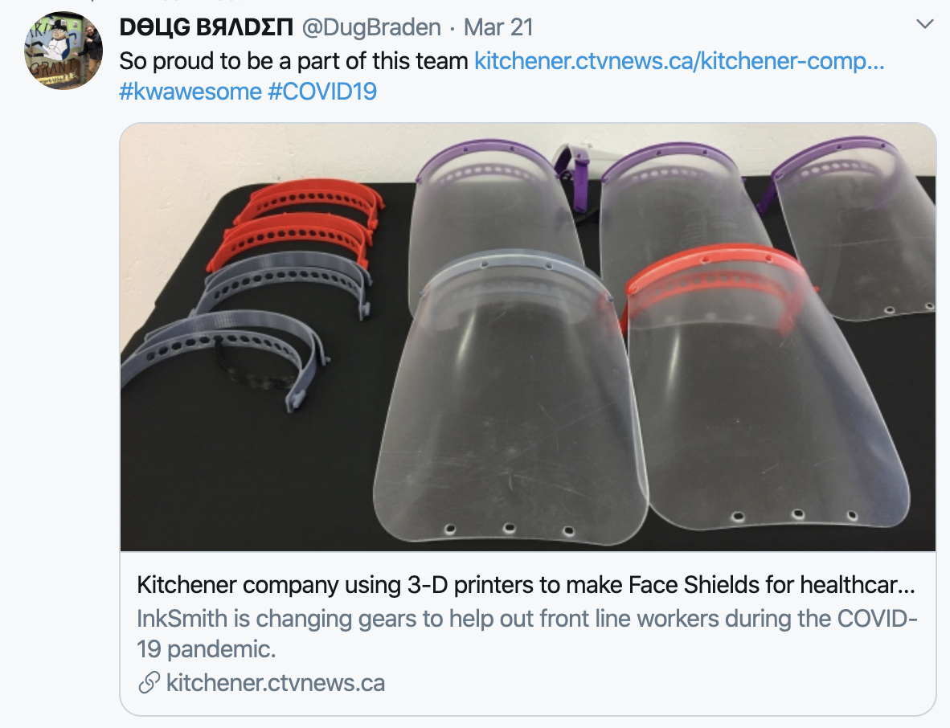
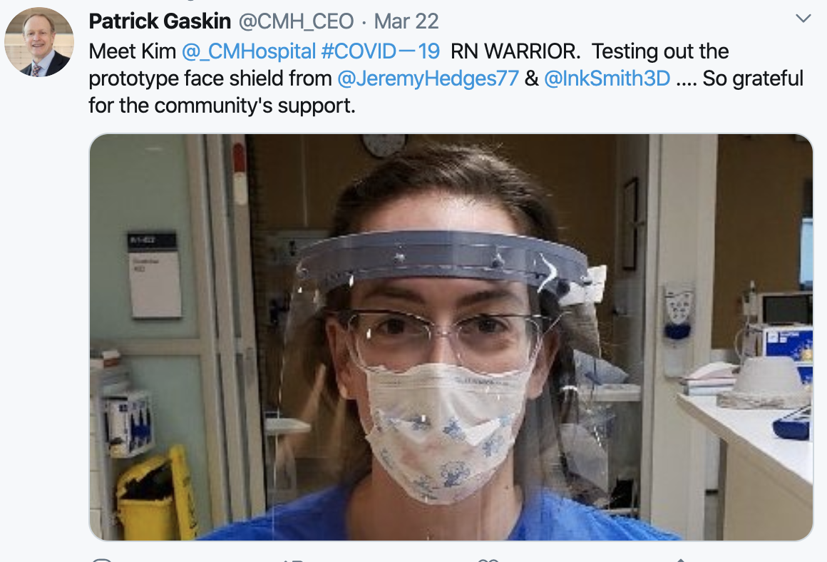

SHOUTOUT!
@Inksmith3D
Notes:
The other thing I’m always looking for are the ways people use technology for GOOD! And this is really the inspiration for this session today. My friends Doug, Andrew and Jeremy work for a company called Inksmith3D. What do you think the 3D stands for in that name? If you guessed 3D printing you are correct! They just got their Health Canada certification to be making masks for the covid front line workers we are so proud of them! They are partners with us on Code to Learn to provide micro:bits and Climate Action kits that work with them. So...you might be interested in technology like they are, and also interesting in one day using tech to make the world a better place - we love that!

Slide 9
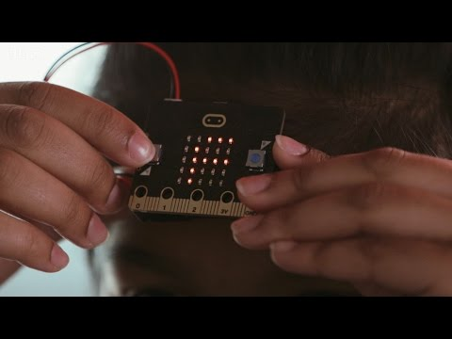
What is a
Microbit?

Slide 10
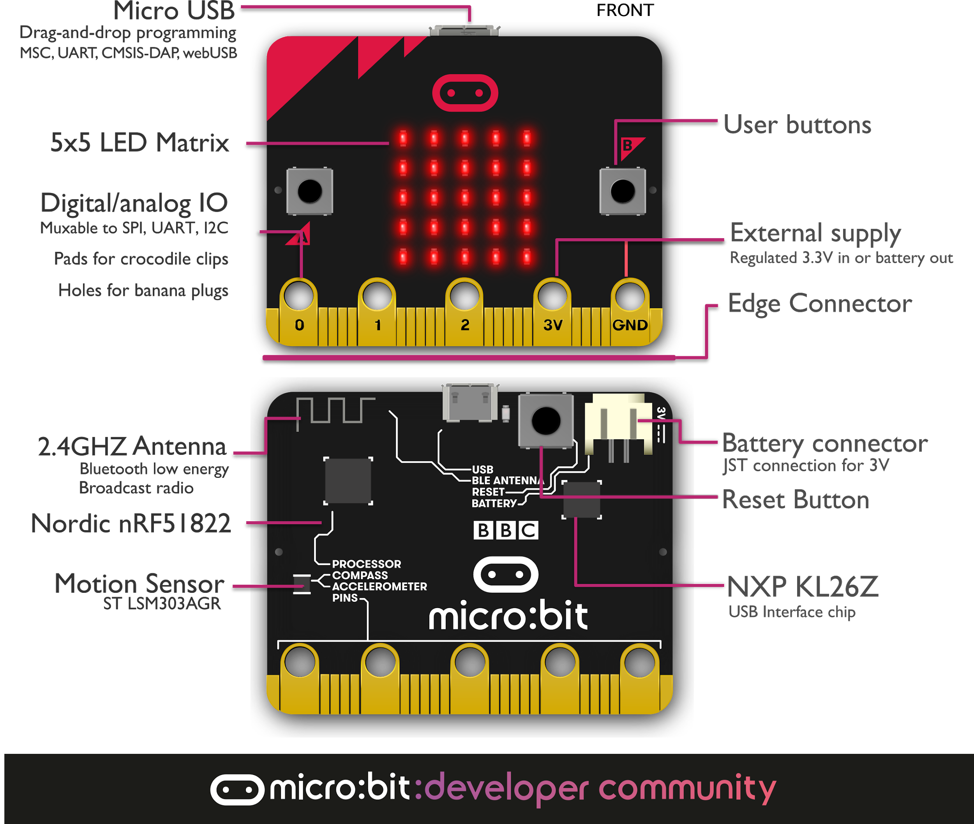

Slide 11
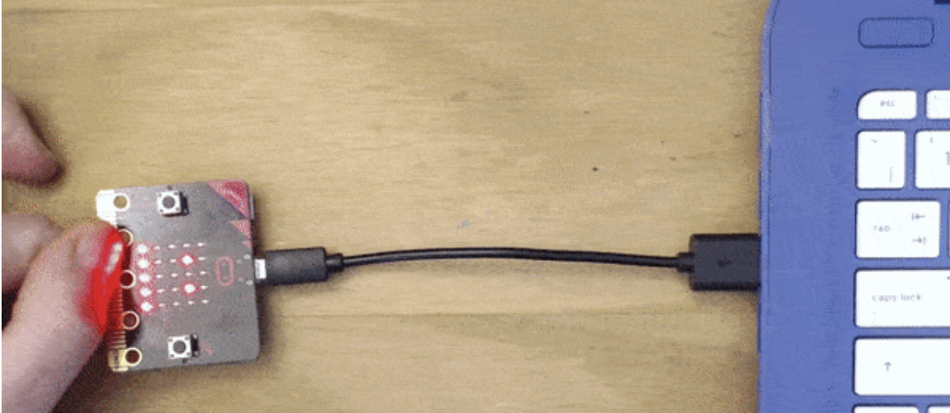

Slide 12
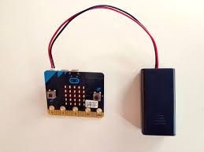

Slide 13
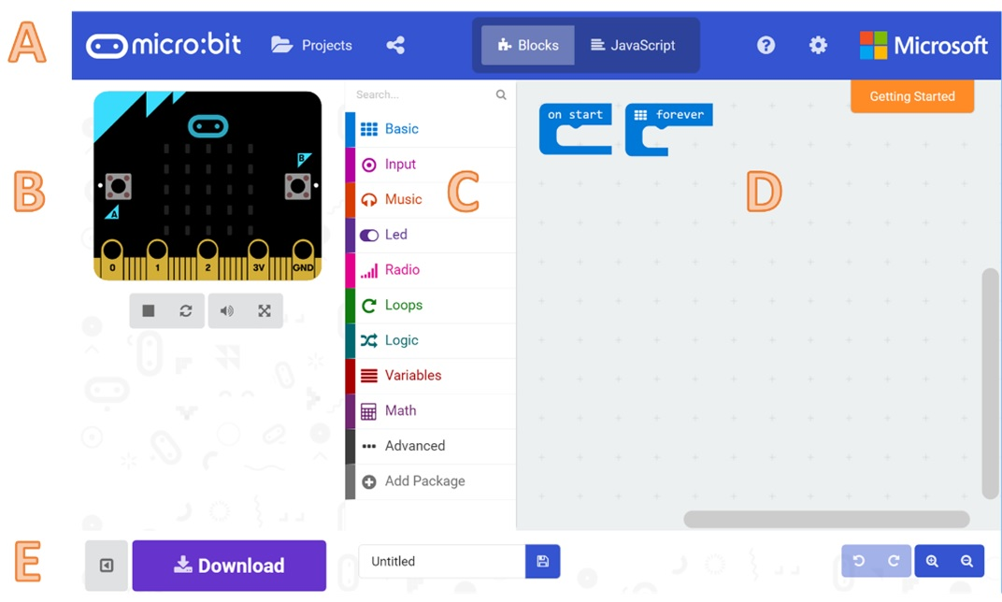

Slide 14
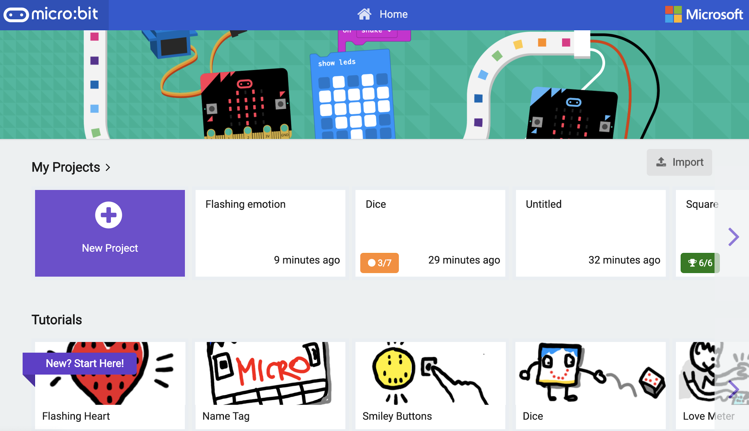
https://makecode.microbit.org/

Slide 15


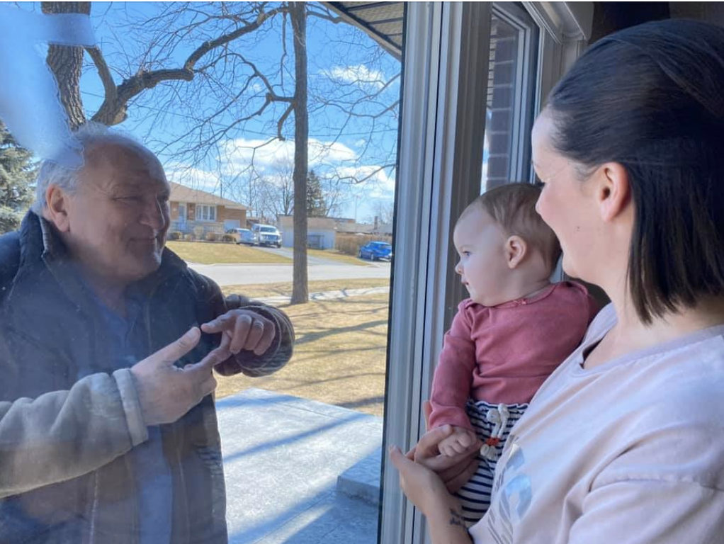
Using LEDS
Using buttons
Notes:
What positive messages might we be wanting to send to the people in our lives? A thank you, a hello, an I love you, a joke….

Slide 16
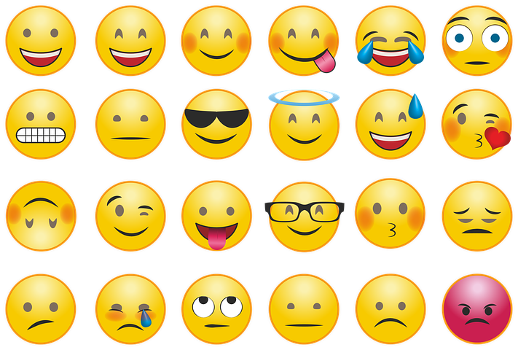
How are you feeling today?
Flashing Emotions
2 buttons
Icons
Pause
Repeat
Notes:
Sharing spaces - we don’t have our usual routines, we might be crowded - everyone will have different moods at different times.
All of our feelings are ok to have - it’s better if we can talk about them too...

Slide 17
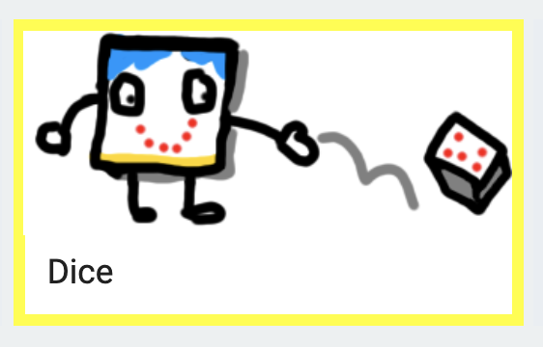
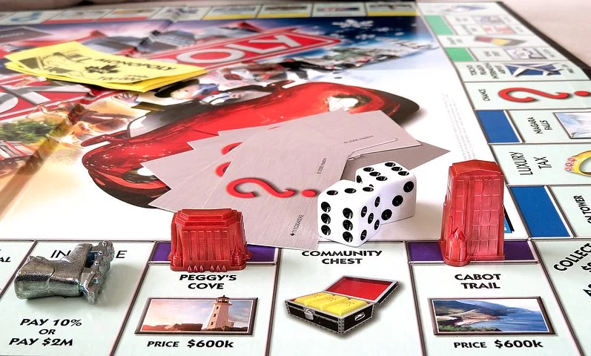
Random numbers
Shake command

Slide 18
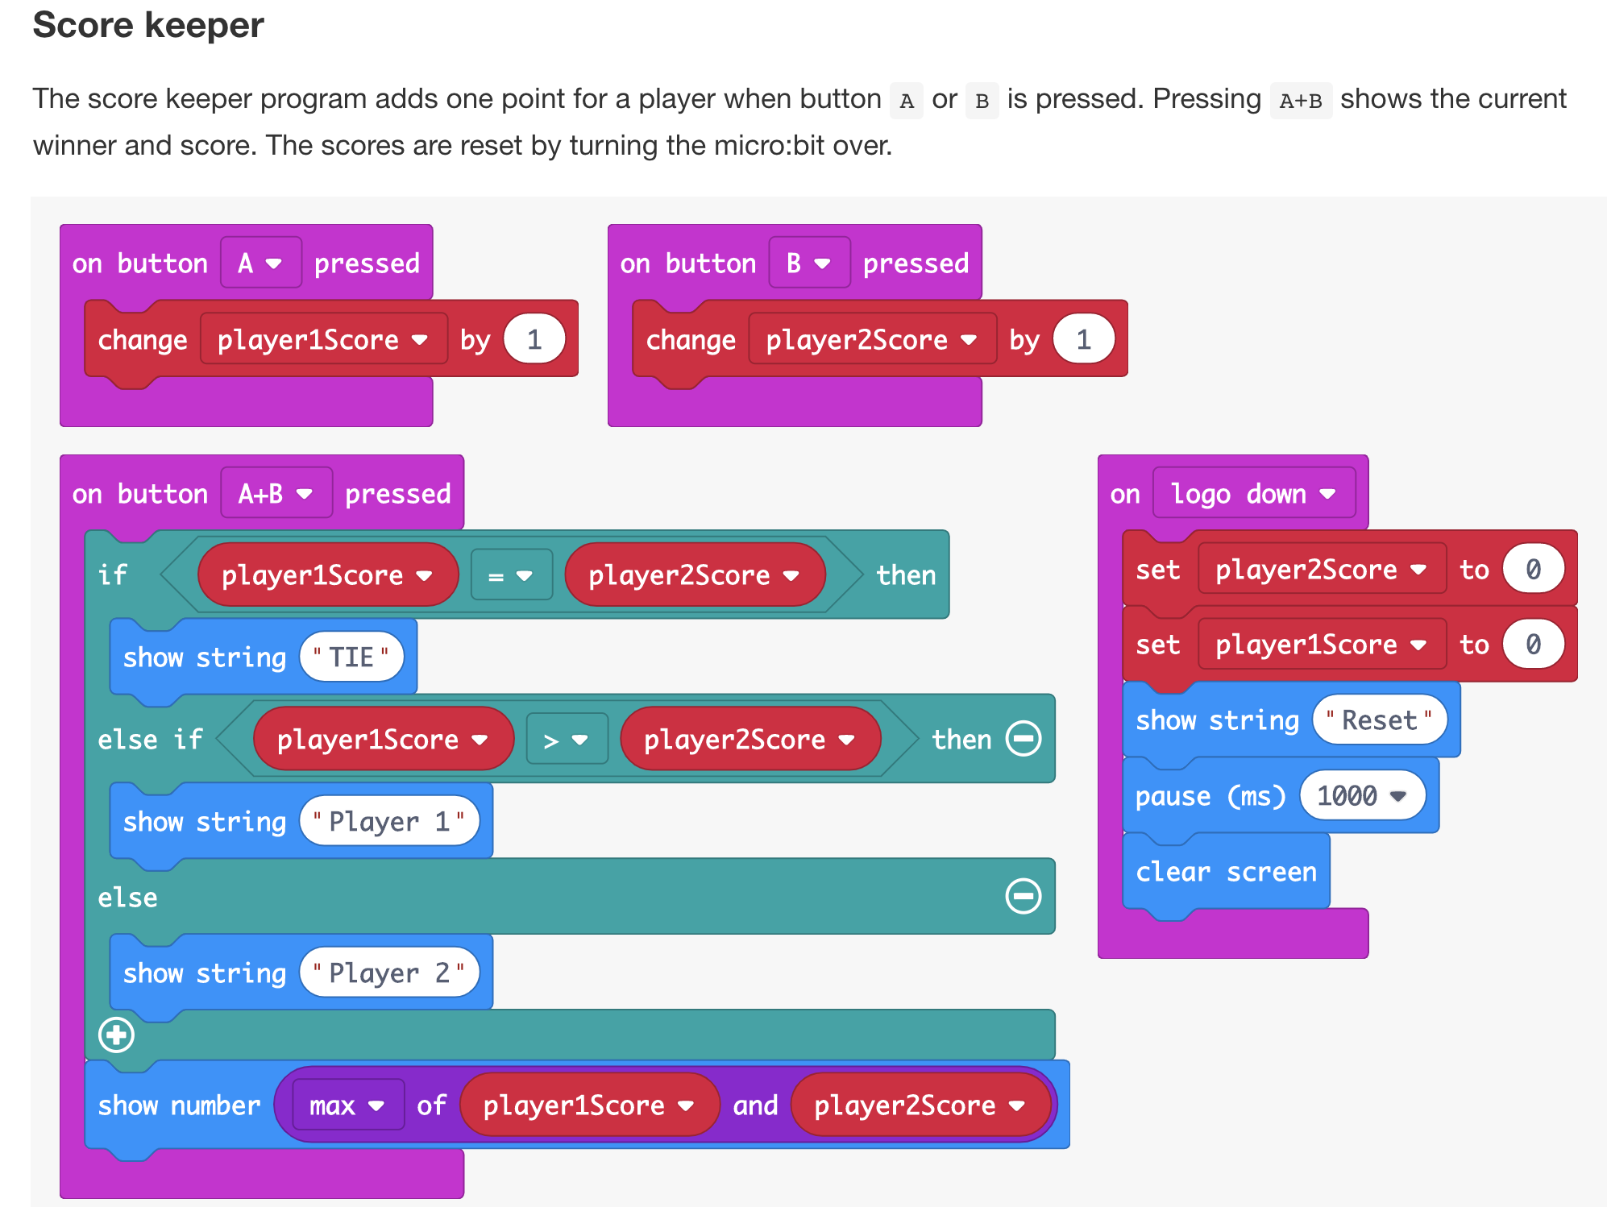
https://makecode.microbit.org/projects/salute
All Buttons
Strings
If...else if...else
Logo Down?

Slide 19
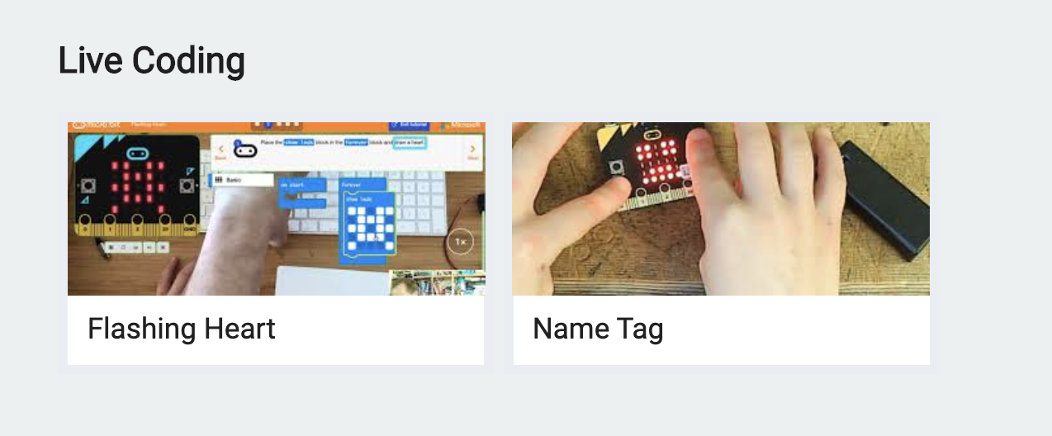

Slide 20
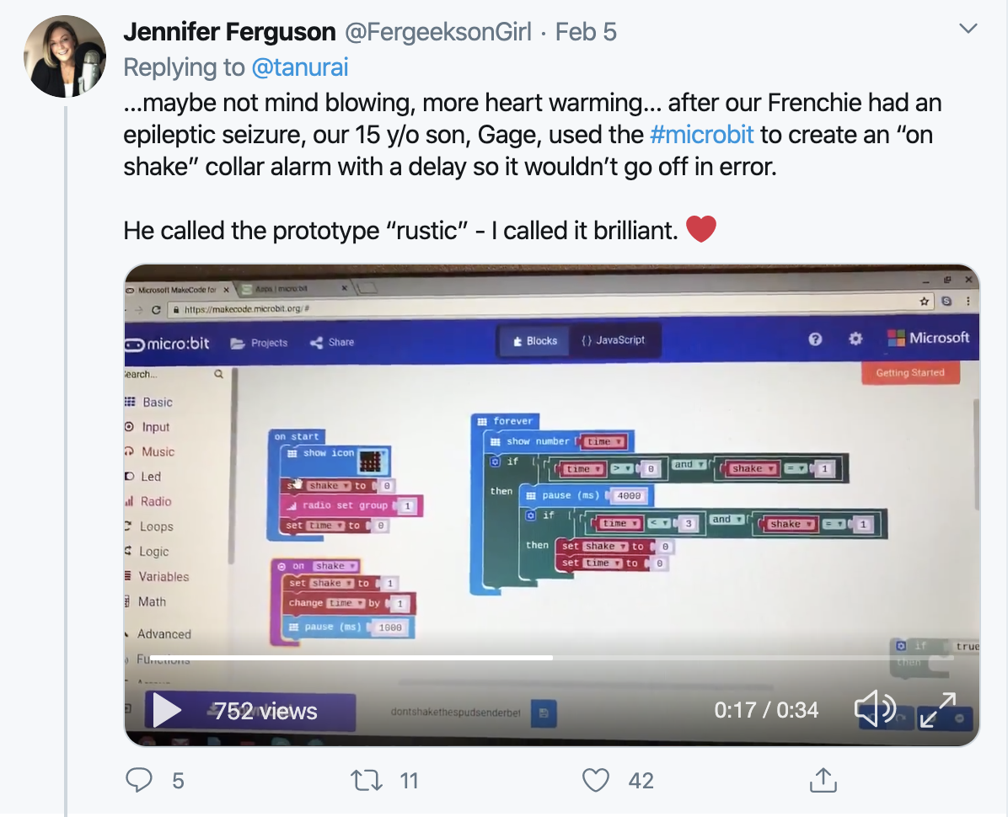

Slide 21
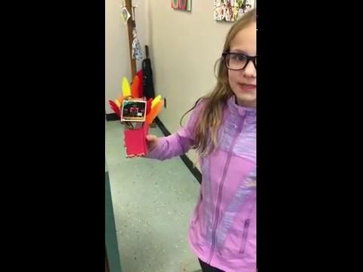
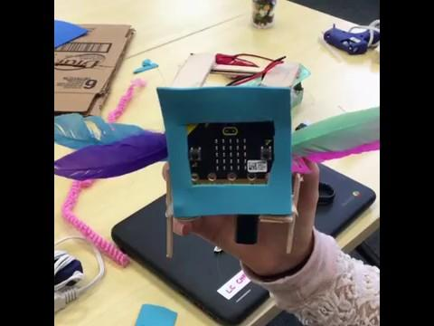
The “Micropets”

Slide 22
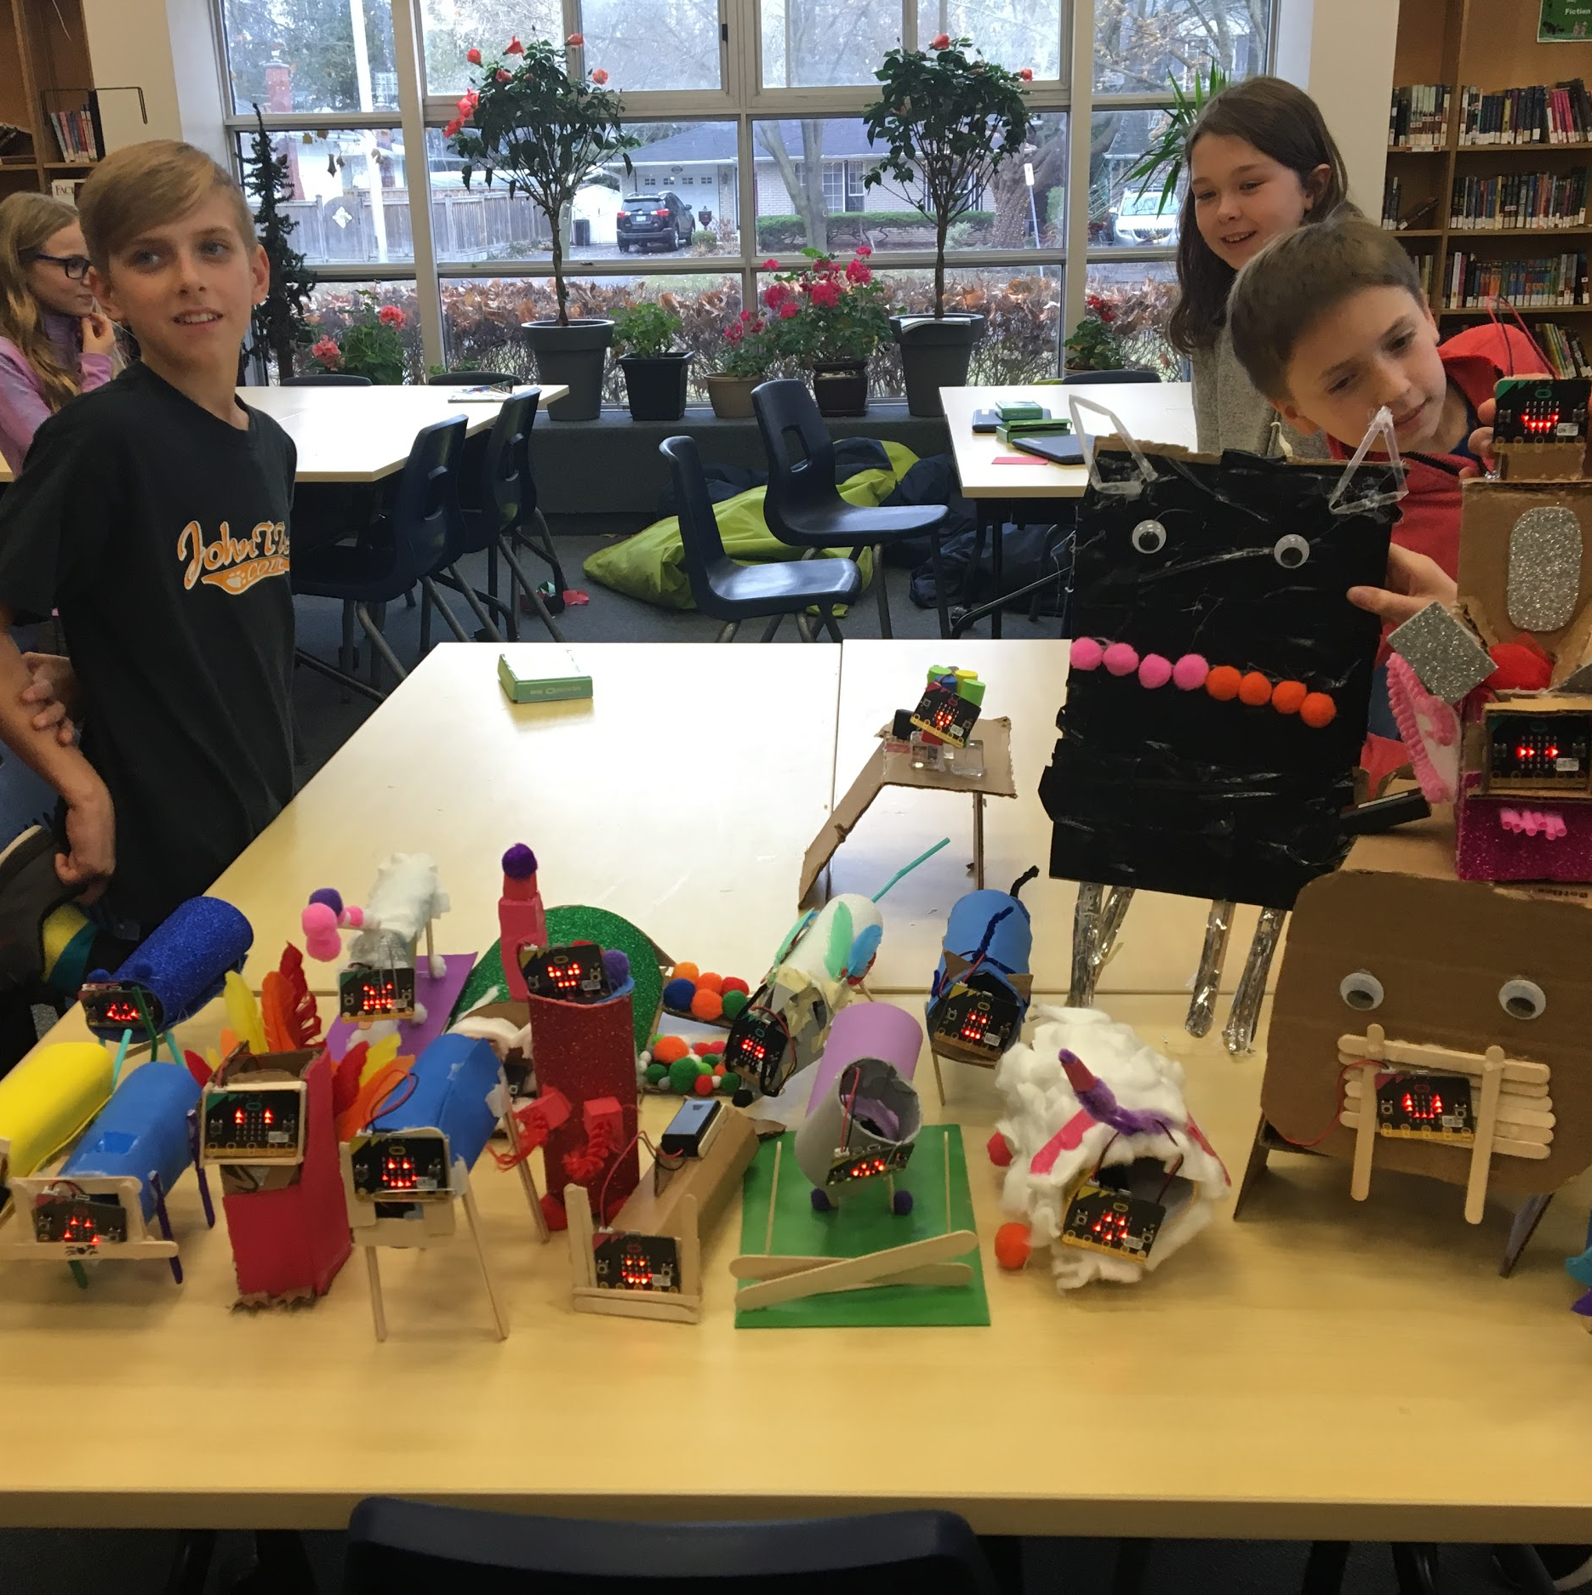

Slide 23
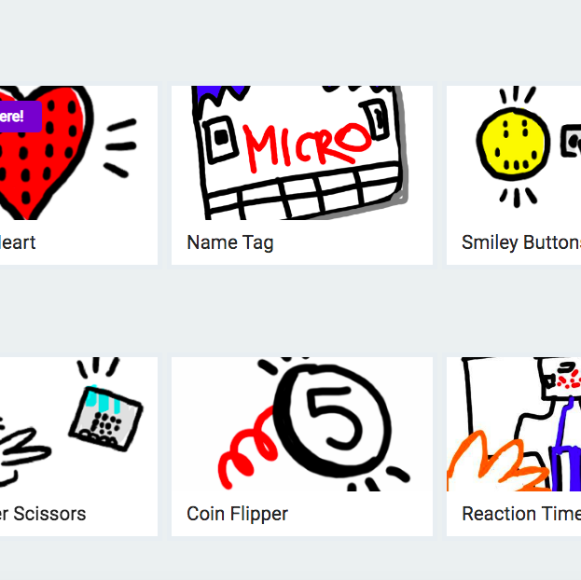
Microbit Tutorials
An easy way for anyone to get started...

